Slide 1

Project Risk Management
Analyzing and Planning for Risk
Slide 1
Notes:
1

Slide 2
Risks driven by Poor Project Processes
Slide 2
Not following the strategic project planning model
Taking short cuts
Not monitoring the project
Not prioritizing customer needs and expectations
Not bringing the right people to the project
Notes:
2

Slide 3
Typical Project
Risk Factors
Slide 3
Supplier performance failures
Supplier cost overruns
Engineering or design changes
Project management failures
Production process errors
Testing errors
Equipment design errors
Notes:
3
Where are the risks in your current project?

Slide 4
Typical Project
Risk Factors
Slide 4
Product reliability errors
Product or service costing errors
Start up problems
Learning curve problems
Personnel skill set deficiencies
Cycle times
Consumer safety issues
Notes:
4

Slide 5

Surprises
Slide 5
Suspension of project funding
Withdrawal of team resources
Supplier or support team failures
Changes in team or leadership
Changes in technologies or standards
Changes in market or competitive environment
Changes in the customer’s economic condition
Notes:
5
Project failures that are harder to specifically predict, though you know that they can happen
Example: Denver International Airport
United Airlines, the dominant carrier, wanted to open the airport sooner than the project plan by a considerable number of months.
The supplier of the baggage system had originally estimated it would take 4 years to complete the system. They were now being required to complete it in 2-½ years.
The baggage system failed totally, damaging and/or not delivering baggage as required.
The airport opened 8 months behind the new schedule.

Slide 6
Acceptable Risk
Acceptance of Risk
Pain
Slide 6
Notes:
6

Slide 7
Analysis Tools
Qualitative Risk Assessment
Risk Measurement
SIPOC
FEMA
Risk Quantification
Criticality

Slide 8
Qualitative Risk Assessement
Based on Risk Management Plan
  Categories defined
  Common risks defined
Unique risks defined
Project Plan risks defined, for example:
  Planning issues
  Project scope
  Organizational
Define set of risks
Define Risk register list

Slide 9
Qualitative Risk Assessment Level 1
Risk | Assumptions | Understanding of Risk | Data | Reliability of Information
Software may not be compatible with new system | System uses new language Old system more than 10 years old | Don’t understand new language yet Few people who can program old system | Some data available | Poor
Component B will arrive late | Vendor frequently late | New vendors available but untested | Poor data | Good
Customer Process broken | Process broken, skills weak | Don’t understand process well | Poor data | Weak
A simple risk register

Slide 10
Golden Tools: SIPOC and FEMA
SIPOC – Tool for identifying stakeholders and processes. Very useful for thinking through real customers.
FEMA – Method for looking at potential or current failures, assigning a severity, business impact, occurrence and risk level. Typically manufacturing, but used in many industries. Helps focus on root failures.
Both are proactive tools for the planning phase.

Slide 11

SIPOC
(Analysis Tool)
Six Sigma diagram tool to identify all relevant elements in a process.
  Suppliers
  Inputs
  Process
  Outputs
  Customers
Each element can then be analyzed for risk

Slide 12
SIPOC Diagram
Inputs
Cars
Option Packages
Suppliers
Manufacturer
Suppliers
Gas Station
Car Wash
Printer
Fuel for Cars
Car Washes
Car Repairs
Process
Outputs
Customers
See Process
Paperwork to Dealer
Carr Buyers
New Client Account
Paperwork to State
Paperwork to Manufacturer
Payment
Service Contract
Service Notifications
Requirements
Dealership Owners
Department of Motor Vehicles
Service Department
Color Selection
Build to Order
Paperwork filed within 28 hours
Local Checks, Cash or Money Orders
Car Dealer Example
Negotiate agreement on options price and delivery
Sign paperwork and deliver car
Meet with new client
Understand client car needs
Present options and test drive
Six Sigma

Slide 13

Case Study
Using a SIPOC Diagram

Slide 14
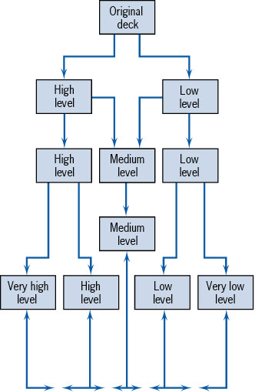
The Q-Sort Method

Slide 15
Q-Sorted Risks
(with output from SIPOC)
Risk | Assumptions | Understanding of Risk | Data | Reliability of Information
Sales process not understood | Vendor will need to assist | RFP Risk | No Data | Very weak
Sales Process Needs redesign | Vendor must work with sales | Skill Mismatch | Poor data | weak
Customer Process broken | Process broken, skills weak | Don’t understand process well | Poor data | Weak
Component B will arrive late | Vendor frequently late | New vendors available but untested | Poor data | Good

Slide 16
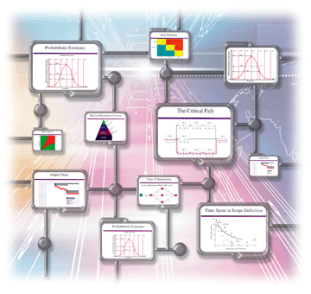
Project Plan Risks
Scope Change
Schedule Risk
Resource Risk

Slide 17
Project Plan Risk
Risk | Assumptions | Understanding of Risk | Data | Reliability of Information
Sales process not understood | Vendor will need to assist | RFP Risk | No Data | Very weak
Sales Process Needs redesign | Vendor must work with sales | Skill Mismatch | Poor data | weak
Customer Process broken | Process broken, skills weak | Don’t understand process well | Poor data | Weak
Team Cohesion | Team has not worked together | Need info on team | Poor Data | OK
Component B will arrive late | Vendor frequently late | New vendors available but untested | Poor data | Good

Slide 18
Define the Impact of the Risk
Impact describes the possible damage or benefit to a project when a risk or opportunity occurs:
Costs
Quality
Performance
Time
Risk Influences

Slide 19
Impact After the Project
The benefit or opportunity can also occur after the project:
Profitability
Acceptance
Safety
Risk Influences

Slide 20

Define the Probability of the Risk
Very Low – 1 or 2: Unlikely to occur, but some possibility exists.
Low 3 – 4: More likely but less than a 40% probability.
Moderate 5 – 6: Perhaps a 50 or 60% chance.
High 7- 8: Much more likely.
Higher than 8: Extremely likely: if not taken care of it will turn into a problem right away.

Slide 21

Rate the Impact on a Scale
A risk that turns into a problem can have catastrophic impacts –
If there is a contractually define penalty for non performance a delay of 5 to 10 percent may eat up all of the project profit…

Slide 22
Simple Qualitative Assessment
8
7
6
5
4
3
2
1
8 | 16 | 24 | 32 | 40 | 48 | 56 | 64 | 72 | 80
7 | 14 | 21 | 28 | 35 | 42 | 49 | 56 | 63 | 70
6 | 12 | 18 | 24 | 30 | 36 | 42 | 48 | 54 | 60
5 | 10 | 15 | 20 | 25 | 30 | 35 | 40 | 45 | 50
4 | 8 | 12 | 16 | 20 | 24 | 28 | 32 | 36 | 40
3 | 6 | 9 | 12 | 15 | 18 | 21 | 24 | 27 | 30
2 | 4 | 6 | 8 | 10 | 12 | 14 | 16 | 18 | 20
Probability
1 2 3 4 5 6 7 8 9 10
Impact

Slide 23
Register with Qualitative Assessment
Risk | Assumptions | Understanding of Risk | Data | Reliability of Information | Score
Sales process not understood | Vendor will need to assist | RFP Risk | No Data | Very weak | 72
Sales Process Needs redesign | Vendor must work with sales | Skill Mismatch | Poor data | weak | 32
Customer Process broken | Process broken, skills weak | Don’t understand process well | Poor data | Weak | 60
Team Cohesion | Team has not worked together | Need info on team | Poor Data | OK | 25
Component B will arrive late | Vendor frequently late | New vendors available but untested | Poor data | Good | 42

Slide 24
Example
New hybrid laptops must be purchased from a Taiwanese company to get the best prices, and the purchase will take place over two years. Those prices are in Taiwan Dollars not Pesos. The currency conversion has fluctuated by as much as 10% in the past few months. Is this a risk? Probability and Impact? How would you manage the risk?

Slide 25
More Complete Register
Risk | Assumptions | Understanding of Risk | Data | Reliability of Information | Score | Mitigation
Sales process not understood | Vendor will need to assist | RFP Risk | No Data | Very weak | 72 | Improve data. Provide training prior to roll out
Sales Process Needs redesign | Vendor must work with sales | Skill Mismatch | Poor data | weak | 32 | Train sales people in new processes based on new design
Currency conversion for new Hybrid purchases | Currency conversion fluctuates significantly over time | Previous 10 months showed 10% variation, more in past | Good Data | Excellent | 48 | Hedge risk financially

Slide 26
Case Study
Analyzing Impact and Probability

